Slide 1
Lending Environment Simulator and Lender Evaluator Models
ML-1030 Capstone Project. Client: KASI Insight
Vadim Spirkov, Murlidhar Loka
York University. School of Continuing Studies. September 15th, 2019

Slide 2
KASI Insight Process
Lending Environment
Survey Lenders
Analyze Data
Money lending between the individuals is very common and popular. This practice could be viewed as a substitution to the small loan franchises, which are widespread in Western countries
Dozens of hubs in seven African countries welcome private lenders to take survey. The surveys are being conducted on monthly basis
KASI Insight leverages the wisdom of the crowd to evaluate lending activities within a community over time to compute a community-based score.

Slide 3
Challenges
How can we apply the survey data collected by KASI Insight to evaluate credit score of the community members?
Could the data be used to create other valuable products?
Can we employ Machine Learning techniques to produce a valuable content for KASI Insight?
I personally think if something's not a challenge, there's no point doing it, because you're not gonna learn much.
Tom Holland

Slide 4
Lender Perspective
Banker Perspective
How my profit will be affected if I change my lending practice?
How to evaluate the credit worthiness of the community to establish quick loan business?

Slide 5
Solution
An ML model could be trained on the survey answers to assign a credit category. But we missed the labels
KASI Insight team came up with a formula to label each observation
Lending Environment Simulator

Slide 6
Other Possible Ways to Use Survey Data
Financial institutions wanting to have a proxy to conduct money lending business in their behalf within various communities would be interested to evaluate the business savviness of the potential candidates.

Slide 7
Solution
We believed that the surveys not only reflect the credit worthiness of the general public but also describe the proficiency, knowledge and experience of the lender as a business partner
In this context KASI Insight team created another formula to add lender savviness label to each observation
Lender Evaluator

Slide 8
Credit/Lender Categories
1 - Very Poor
2 - Poor
3 - Fair
4 - Good
5 - Very Good

Slide 9

KASI Tools

Slide 10
Explore raw survey data. Categorize and impute
Identify the most important features. Find correlated features. Reduce dimensionality
Deliver cloud-friendly, turnkey solution
Raw data exploration & cleaning
Data exploration
Feature Selection
Model Training & Evaluation
Deployment
Understand demographic stats, economic sentiment and spending & borrowing habits
Establish evaluation criteria. Test three algorithms of each model. Pick the winners. Experiment with the input data dimensionality. Apply hyper-parameter tuning.

Slide 11
Data
Raw Survey Data
Data Processing
Seven African countries
36 multi-choice questions
About 30,000 observations
The answers stored as alphanumeric values
The answers have been modified over time leading to data pollution
Convert alphanumeric values to numeric categories
Fill the missing data with the most popular answers
Apply the formulas to assign credit and lender categories to each observation
Save clean data in *.csv file

Slide 12
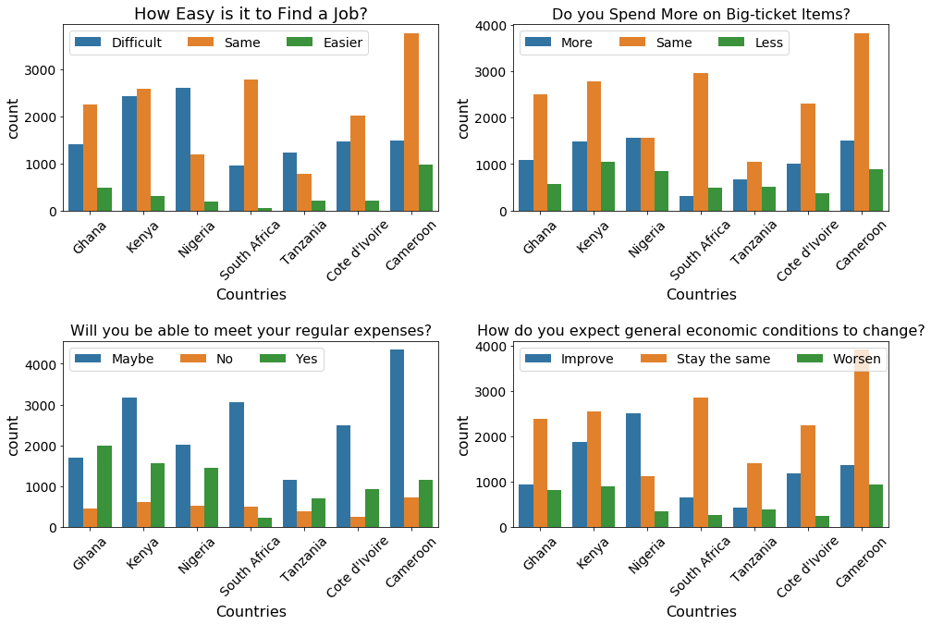
Economic Sentiment

Slide 13
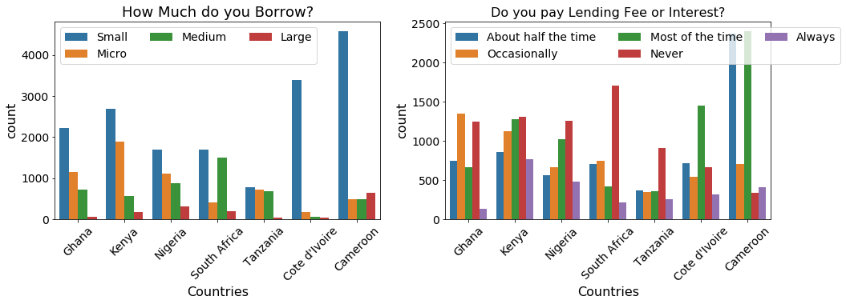
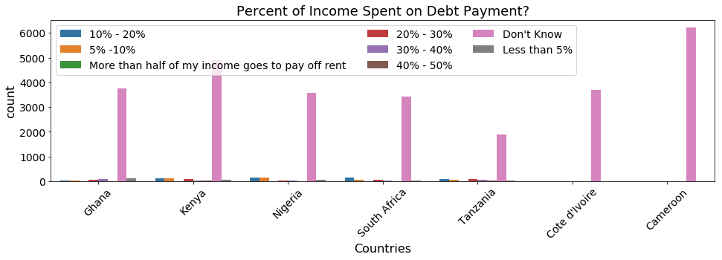
Spending & Borrowing Habits

Slide 14
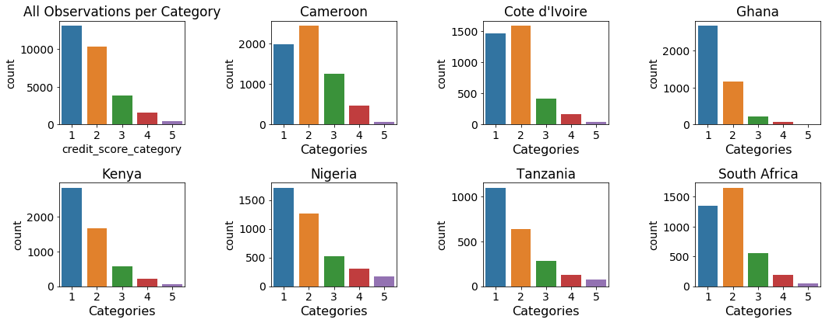
Data Distribution

Slide 15
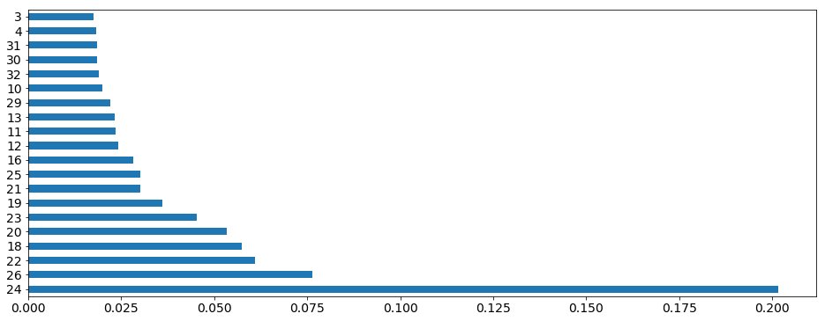
Simulator Feature Importance
ID | Feature
24 | Do you receive your money back in time?
26 | What’s the most common use of the money you lend?
22 | Do you include either interest or a lending fee when you lend?
18 | Over the past 3 months, how many times have you lent someone money?
20 | Who did you lend money to in the past 3 months?
23 | Do you request guarantees when you lend?
19 | On average how much do you lend in general?

Slide 16
Evaluator Feature Importance
ID | Feature
24 | Do you receive your money back in time?
18 | Over the past 3 months, how many times have you lent someone money?
22 | Do you include either interest or a lending fee when you lend?
23 | Do you request guarantees when you lend?
20 | Who did you lend money to in the past 3 months?
26 | What’s the most common use of the money you lend?
19 | On average how much do you lend in general?
25 | Assuming that you have lent money at least ten times, how often would you get your money repaid?
16 | Country

Slide 17
ML Algorithms
Evaluation Metrics
We believe that the best model has to classify all five categories as accurate as possible. The winning model also would have to identify true positives and true negatives for each category equally well.
Thus we choose the multiclass confusion matrix and F1 scores to evaluate the models.
Support Vector Machine
Random Forest
Gradient Boosting Machine

Slide 18
Split the data into the training (70%) and test (30%) sets. Make sure that the training set has proportional representation all 5 categories
Employ SVM, Random Forest and GBM classifiers with default parameters. Evaluate algorithm performance using F1 score. Pick a winner
Finally hyper-tune the algorithm parameters in effort to achieve even better model performance
Split data into training & test sets
Upsample Training Set
Evaluate three algorithms
Change dimensionality
Tune hyper parameters
Evaluate the winning algorithm fitting it with the smaller and larger feature sets.
Simulator - 5 & 9 (7 - base-line)
Evaluator - 7 & 10 (9 base-line)
Change the input data dimension if it improves the model performance
Upsample the training data set employing SMOTE algorithm

Slide 19
And the Winners Are….

Slide 20
Simulator Model
Random Forest
Nine features
Overall algorithm accuracy: 0.9594
Category | Precision | Recall | F1-score | Support
1 | 0.99 | 0.99 | 0.99 | 3940
2 | 0.96 | 0.96 | 0.96 | 3098
3 | 0.91 | 0.90 | 0.90 | 1154
4 | 0.83 | 0.88 | 0.86 | 471
5 | 0.89 | 0.87 | 0.88 | 152
Micro avg | 0.96 | 0.96 | 0.96 | 8815
Macro avg | 0.92 | 0.92 | 0.92 | 8815

Slide 21
Evaluator Model
Random Forest
Ten features
Overall algorithm accuracy: 0.9756
Category | Precision | Recall | F1-score | Support
1 | 0.99 | 0.99 | 0.99 | 4110
2 | 0.98 | 0.98 | 0.98 | 3237
3 | 0.94 | 0.96 | 0.95 | 1217
4 | 0.90 | 0.82 | 0.86 | 214
5 | 0.96 | 0.73 | 0.83 | 37
Micro avg | 0.98 | 0.98 | 0.98 | 8815
Macro avg | 0.95 | 0.90 | 0.92 | 8815

Slide 22
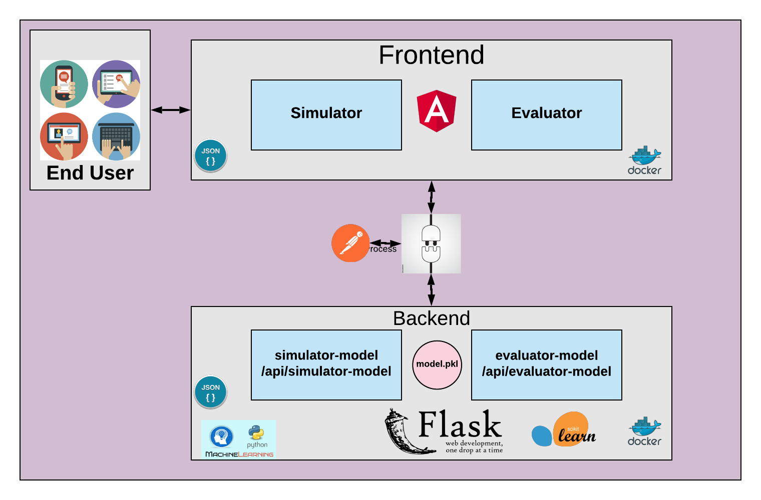
System Architecture

Slide 23
IMPACT
Illustrated to our business partner how ML could be applied to a real life problem
Showed what it takes to create ML-based production pipeline
Laid a foundation to future enhancements of the models we designed

Slide 24

max growth

